Slide 1




Quantifying Compost Cats Greenhouse Gas Emission Reductions
Arizona/NASA Space Grant Undergraduate Research Internship Statewide Symposium
The University of Arizona
April 21, 2012
Emily Toffol
UA/NASA Space Grant Research Intern
UA Office of Sustainability
Joe Abraham, PhD
Director
UA Office of Sustainability

Slide 2


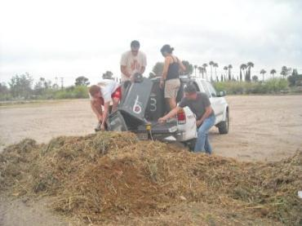
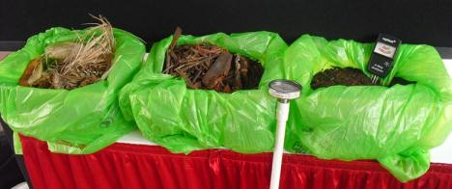

Composting & Compost Cats
Photos courtesy of Compost Cats
ASUA logo: http://asua.arizona.edu/ASUASite/ASUA.html
Compost Cats logo: http://compostgolive.blogspot.com/

Slide 3

Why Assess GHG reductions?
Commitment to reduce emissions and contribute to a low-carbon society
www.climateaction.arizona.edu
Image: http://www.presidentsclimatecommitment.org/

Slide 4
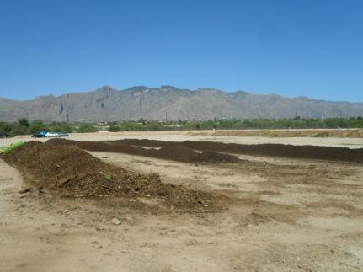
Research Questions
How effective is the Compost Cats program at reducing emissions due to organic waste?
How can the Compost Cats better monitor their emission reductions?
How can Compost Cats reliably inform business partners of their GHG reductions?
Photo courtesy of Compost Cats

Slide 5

Methods
Climate Action Reserve (CAR) Organic Waste Composting Protocol
CAR Protocols are playing a part in the emerging California cap and trade system being developed by the Western Climate Initiative
Developed and reviewed by industry experts, federal agencies, and environmental organizations.
Image: http://www.climateactionreserve.org/

Slide 6
Determining Emission Reductions
Business-as-Usual Emissions
VS
Compost Project Emissions

Slide 7
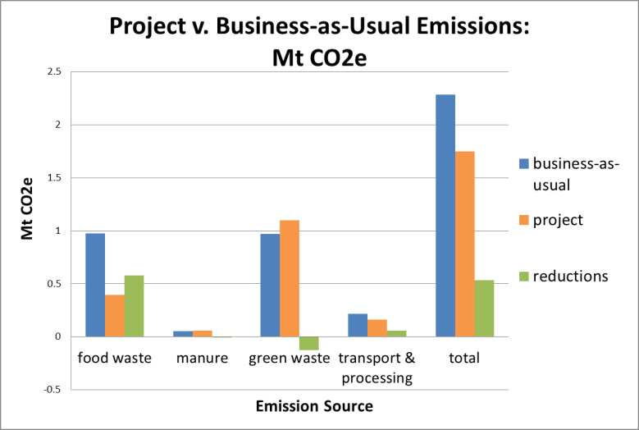
Results

Slide 8
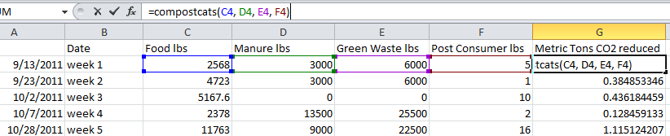


Calculator Tool
Climate Action Reserve Protocol: http://www.climateactionreserve.org/how/protocols/organic-waste-composting/

Slide 9
Thank You !
etoffol@email.arizona.edu

